Slide 1


TECHTRONIX a hi-techCASE STUDY
CAPSTONE PROJECT PREPARED BY
SALAMI, AYODEJI OLUWADAMILARE

Slide 2
Table of content
INTRODUCTION
DATASET OVERVIEW
METHODOLOGY
DATA VISUALIZATION
ANALYSIS FINDINGS/INSIGHT
RECOMMENDATION
CONCLUSION

Slide 3
INTRODUCTION
TECHTRONIX INNOVATIONS, A FOREFRONT PLAYER IN THE MICROCHIP AND ROBOTICS INDUSTRY, IS ENCOUNTERING CHALLENGES IN STREAMLINING ITS SALES STRATEGIES, OPTIMIZING PRODUCTION PLANNING, AND PURSUING MARKET EXPANSION. THE COMPANY BOASTS AN EXTENSIVE PORTFOLIO THAT CATERS TO AUTOMOTIVE, CONSUMER ELECTRONICS, AND INDUSTRIAL SECTORS. HOWEVER, IT GRAPPLES WITH DEMAND UNPREDICTABILITY, INVENTORY MANAGEMENT INEFFICIENCIES, AND THE IDENTIFICATION OF PROFITABLE MARKET OPPORTUNITIES. OVER THE PREVIOUS YEAR, TECHTRONIX INNOVATIONS HAS METICULOUSLY COMPILED A DATASET ENCOMPASSING EACH TRANSACTION, ENCOMPASSING SALES DATA, CUSTOMER INTERACTIONS, PRODUCT SPECIFICS, AND FINANCIAL METRICS. THIS DATASET PRESENTS AN INVALUABLE OPPORTUNITY FOR IN-DEPTH BUSINESS PERFORMANCE ANALYSIS, TREND IDENTIFICATION, AND INSIGHT EXTRACTION TO INFORM STRATEGIC DECISIONS.

Slide 4
Primary objectives
Streamlining Sales Strategies:
Techtronix aims to overcome challenges in refining its approach to sales, likely through data-driven insights.
Optimizing Production Planning:
The company faces issues with production planning and seeks to improve the efficiency of this process.
Addressing Demand Unpredictability:
Techtronix struggles with forecasting demand accurately and wants to reduce unpredictability.
Improving Inventory Management:
There are inefficiencies in managing inventory, and the company needs to address these issues to better align supply with demand.
Identifying Profitable Market Opportunities:
Techtronix is looking to explore and identify new markets that provide higher profitability to fuel their growth.
Leveraging Data for Strategic Decisions:
The dataset compiled from transactions, customer interactions, product details, and financial metrics provides an opportunity for comprehensive analysis, including:
Performance analysis
Trend identification
Insights to inform strategic decisions for future growth

Slide 5





Data Visualization
Methodology
Data Analysis
Data
Preparation
Data
Collection

Slide 6



DATA COLLECTION AND PREPARATION
Data Collection : The dataset was provided by 10Alytics Project team, which includes product information, customer demography and location information
Data cleaning : The data cleaning process includes Data validation and standardization, Column renaming, and Data formatting to maintain data consistency
Data Modelling : Additional calculated table ( calendar) and
calculated column ( Month and Month number) with a one – to – many relationship was created to improve analysis accuracy and optimized over all dashboard performances.

Slide 7



DATA ANALYSIS AND VISUALIZATION
Descriptive Analysis: Use descriptive analysis to analyze past sales trends, evaluate customer behavior, and assess product performance, providing insights into historical business performance and identifying areas for improvement in sales strategies and market expansion efforts.
Predictive Modelling : Utilized Power BI’ s Key Influencer visual to forecast demand, optimize inventory management, and identify profitable market opportunities, enabling data-driven sales strategies and production planning for improved business performance.
Visualization: Created interactive dashboards in Power BI to display key metrics, trends, and influencers.

Slide 8

ANALYSIS FINDING
DATA VISUALIZATIONS AND KEY INSIGHTS

Slide 9
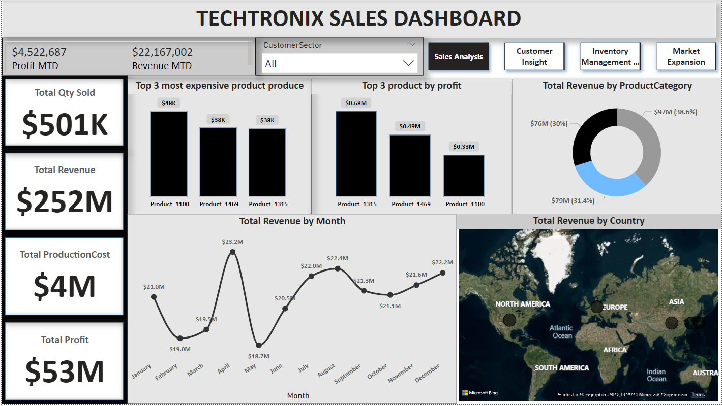
INSIGHT
Top 3 Products by Profit: Product_1315 generated the highest profit, followed by Product_1469 and Product_1100. This indicates these products are key contributors to profitability.
Total Revenue by Product Category: The largest revenue-generating category is the one contributing 38.6% of total revenue, suggesting that focusing on this category could drive further growth.
Total Revenue by Month: Revenue shows a fluctuating pattern, with peaks in April and August. This seasonality should be taken into account for planning production and marketing efforts.
Total Revenue by Country: North America and Europe are significant markets. However, there seems to be potential for growth in Asia, which might be underutilized.
RECOMMENDATIONS
Product Strategy: Focus on increasing production and marketing of Product_1315, Product_1469, and Product_1100 to capitalize on their profitability.
Market Expansion: Consider targeted marketing campaigns in underperforming regions like Asia to tap into untapped potential.
Revenue Optimization: Analyze the factors contributing to the revenue peaks in April and August and replicate these strategies across other months.
SALES ANALYSIS

Slide 10
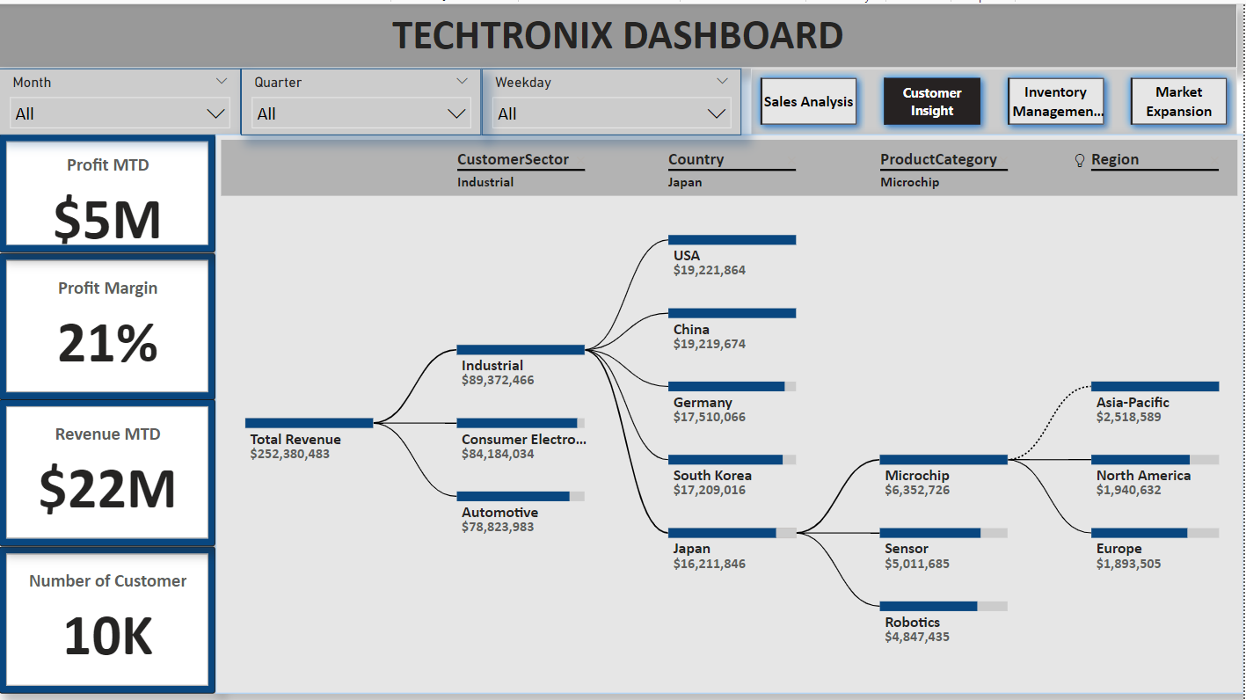
INSIGHT
Profit and Revenue MTD: Profit for the month is $5M with a profit margin of 21%, which is strong. However, further analysis could be conducted on how to maintain or improve this margin.
Customer Insights: The tree diagram indicates the significant contribution of industrial and consumer electronics sectors, particularly from the USA and China.
Product Categories: Microchip and Sensor are key categories, especially in the USA, China, and Germany markets.
RECOMMENDATIONS
Profit Margin Management: Conduct a deeper analysis into cost structures within different sectors to identify opportunities to improve the profit margin beyond 21%.
Sector Focus: Focus on expanding within the industrial and consumer electronics sectors, especially in the USA and China, where there is evident strength.
Product Diversification: Explore further diversification within the Microchip and Sensor product categories to sustain and grow market share in high-revenue countries.
CUSTOMER INSIGHT

Slide 11
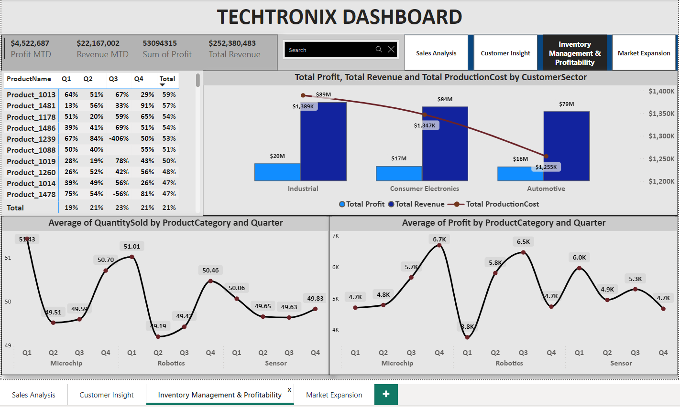
INSIGHT
Profit vs. Revenue vs. Production Cost: The Industrial sector generates the highest profit, followed by Consumer Electronics and Automotive. Production costs are relatively low compared to the revenue generated, which is a good indicator of efficiency.
Quantity Sold and Profit by Product Category: Microchip and Robotics categories see a consistent quantity sold but show fluctuations in profit, indicating potential pricing or cost issues.
RECOMMENDATIONS
Cost Efficiency: Continue to maintain low production costs in high-profit sectors like Industrial. Look into reducing costs further in Consumer Electronics and Automotive for higher margins.
Pricing Strategy: Review pricing strategies for Microchip and Robotics to ensure profitability is maximized without sacrificing sales volume.
Inventory Management: Ensure efficient inventory management in categories with high sales volumes like Microchip and Robotics to prevent stockouts or overstocking.
INVENTORY MANAGEMENT & PROFITABILITY

Slide 12
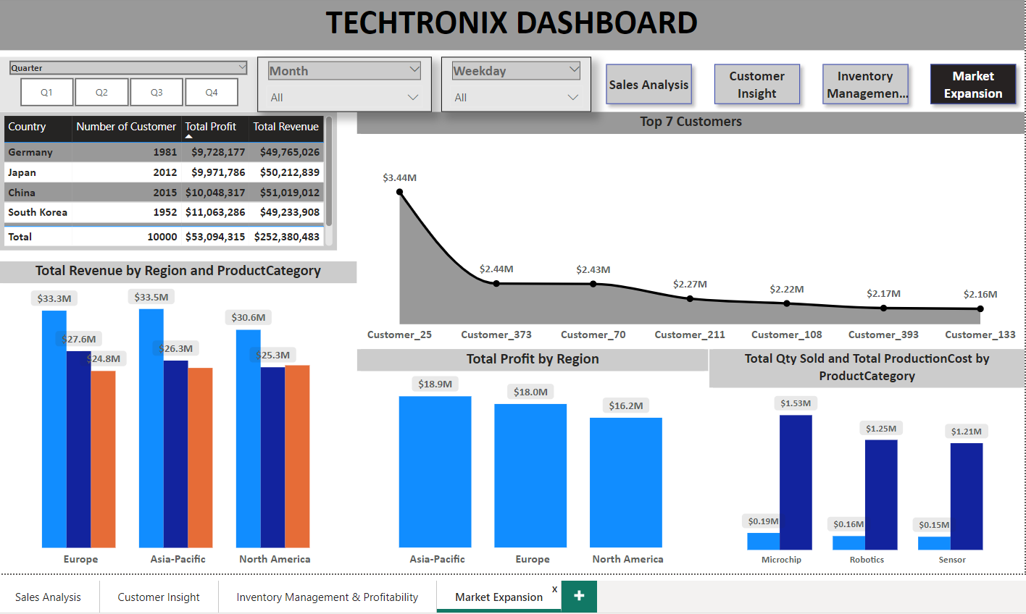
INSIGHT
Regional Revenue and Profit: Europe and Asia-Pacific regions lead in revenue and profit, with North America slightly behind.
Top Customers: The top customer contributes significantly to profits, indicating a heavy reliance on a few key accounts, which could be a risk.
Total Quantity Sold and Production Cost by Product Category: Microchip has the highest quantity sold and a relatively low production cost, making it highly profitable.
RECOMMENDATIONS
Market Diversification: Focus on diversifying the customer base to reduce dependency on top customers and minimize risk.
Regional Focus: Continue to expand efforts in the Asia-Pacific and European markets where revenue and profit are strong and explore untapped potential in North America.
Customer Relationship Management: Strengthen relationships with top customers to ensure loyalty and continued profitability while seeking new high-potential customers.
MARKET EXPANSION

Slide 13
OVERALL RECOMMENDATIONS
Market Expansion Insights:
Regional Revenue Analysis:
The Asia-Pacific and Europe regions each generate substantial revenue, contributing $33.5M and $33.3M, respectively. However, North America lags slightly behind at $30.6M.
Recommendation: Increase market penetration efforts in North America. There is an opportunity to close the revenue gap through targeted marketing, distribution strategies, and pricing optimization.
Country-based Revenue:
China and Japan lead with over $50M in revenue, while Germany and South Korea are also strong contributors with over $49M.
Recommendation: Continue expanding operations in these top-performing countries while exploring potential growth opportunities in underrepresented markets, such as Africa and South America.
Profitability and Cost Analysis:
Total Profit and Cost Management:
The company has maintained a 21% profit margin. However, costs like production costs need more optimization in some sectors. For example, the Automotive sector has higher production costs but lower relative profitability.
Recommendation: Implement cost-saving measures in the Automotive sector while ensuring profitability remains competitive. Consider optimizing supply chain operations or renegotiating supplier contracts.
Product Performance:
Top Product Categories:
The top-performing product category in terms of revenue is the "Microchip" category ($97M), contributing 38.6% of the total revenue.
Recommendation: Continue expanding the production and marketing efforts of the Microchip category, as it has a high revenue contribution. Invest in R&D and new product launches in this category to capitalize on its market share.
Low-performing Products:
Products like Sensors and Robotics have lower revenue contributions. For instance, Sensors brought in only $5M, significantly lower than the top products.
Recommendation: Reassess the strategy for underperforming categories. Either reduce investment in these areas or focus on product improvement and differentiation to increase their competitive positioning.

Slide 14
OVERALL RECOMMENDATIONS
Customer Segmentation & Profitability:
Top Customers:
The Top 7 Customers provide significant revenue, with Customer_25 contributing $3.44M in profit, followed by Customer_373 at $2.44M.
Recommendation: Strengthen customer relationships with these top customers through loyalty programs, special offers, and custom solutions. Upsell and cross-sell to further increase profitability.
Number of Customers:
With 10K customers and total revenue of $252M, customer retention and acquisition strategies should be strengthened to improve market share.
Recommendation: Focus on customer retention programs and attract new customers, particularly in regions with lower engagement like South America.
Seasonal Trends:
Monthly and Quarterly Trends:
May and April show a peak in revenue generation, with May at $23.2M and April at $20.5M. In contrast, months like August and September underperform.
Recommendation: Introduce targeted marketing campaigns and promotional offers during low-revenue months (August-September) to balance seasonal fluctuations. Align production schedules and inventory management with these trends to avoid overstocking or undersupply.
Sector-based Strategy:
Industrial and Consumer Electronics dominate the market, bringing in $89M and $84M in revenue, respectively.
Recommendation: Focus on further segmentation within the Industrial sector, exploring niche markets and expanding into untapped industrial markets. For Consumer Electronics, expand the product portfolio and target emerging markets for higher growth.
Goal-oriented Market Strategy:
Expand into New Markets:
Given the strong performance in Asia-Pacific and Europe, consider market expansion into other emerging regions like Africa, where current revenue contributions are minimal.
Recommendation: Conduct market research to assess demand in these regions and adjust product offerings accordingly. This expansion can help diversify revenue streams and minimize regional market dependency.
Data-driven Decisions:
Leverage the data to continue improving decision-making. Focusing on customer insights and refining the segmentation of products can further drive business growth.
Recommendation: Use predictive analytics to forecast future demand trends and customer behavior, ensuring the company stays ahead of competitors.

Slide 15
CONCLUSIONS
Microchip Category Dominates Revenue: The Microchip product category significantly outperforms other categories, contributing almost 40% of the company's revenue. This highlights its strategic importance for future growth and innovation within Techtronix.
Regional Strength in Asia-Pacific and Europe: With Asia-Pacific and Europe leading revenue generation, these regions are key growth areas. There is potential to further capitalize on their performance through enhanced market presence and localized strategies, especially in countries like China and Japan.
Untapped Opportunities in North America: Although North America contributes a large share of revenue, it still lags behind Asia-Pacific and Europe. Focused expansion efforts and tailored marketing strategies could increase market share and boost revenue in this region.
Underperforming Product Lines: Categories such as Sensors and Robotics generate comparatively low revenue. A review of the strategies for these product lines is crucial—whether to reinvest for innovation or reallocate resources to more profitable segments.
Profitable but Costly Sectors: While profitability is positive at a 21% margin, sectors like Automotive are high in production costs. Cost-saving strategies, such as supply chain optimization, are essential to maintain profitability in high-cost sectors.
Customer Retention is Key: A small group of top customers significantly contributes to profitability. Retaining and nurturing relationships with these customers is crucial, along with focusing on customer acquisition in new and existing markets.
Seasonal Fluctuations Affect Sales: Revenue shows clear peaks in certain months, with May and April outperforming the rest of the year. Addressing off-peak seasons like August and September through targeted promotions could smooth out revenue cycles.
Room for Growth in Emerging Markets: Techtronix has a limited presence in regions like Africa and South America. Expanding into these markets can diversify revenue sources and reduce reliance on existing dominant regions.
Industrial and Consumer Electronics Sectors are Strong Performers: These two sectors dominate the product landscape, and additional segmentation in these areas can provide deeper market penetration and revenue growth.
Strategic Use of Data: The current data highlights clear opportunities for Techtronix to make data-driven decisions, optimizing product offerings, regional strategies, and customer segmentation. Continuous analysis of customer behavior and market trends will be vital for sustained growth and competitiveness.
These conclusions underscore Techtronix’s solid market standing but also reveal areas for improvement, particularly in optimizing costs, expanding into new regions, and addressing underperforming product lines. A strategic focus on these elements will further strengthen the company’s market position.

Slide 16


THANK
YOU!
Contact: https://www.10alytics.io/

